Slide 1
Identification of Optimal New Locations for Freshii - Analysis of MTA Turnstile Data
By: PCKL
(Prad, Carl, Kenny, and Laura)
Notes:
Good afternoon,
Consulting firm in San Francisco. Our consulting firm is named after our names. Our specialty
We not only look at data, we also look at different business aspects.

Slide 2

Problem Statement
What is Freshii?
Rapidly expanding fast casual national restaurant chain
Two locations currently in New York City (NYC), both in Manhattan opened last year
Where should they expand next in NYC?
Notes:
Main competitor - Panera Bread, Just salad
1-2 more location in new neighborhoods within the next year.

Slide 3
Preliminary Analysis
Freshii’s Target Market
Middle income households
Ages 18-54
Health-oriented individuals
Analysis Approach
Identify and segment by borough
Segment by time of day
Identify stations with highest traffic during operating hours
Identify stations with highest local traffic
Notes:
Carl = left through top bullet on right
Kenny = last 3 bullets on right
We used MTA turnstile data, determined where the stations are located geographically within New York City based on the station name and train lines, and filtered out the data to only focus on stations in Brooklyn or Queens and splitting the data into segments throughout the day.

Slide 4
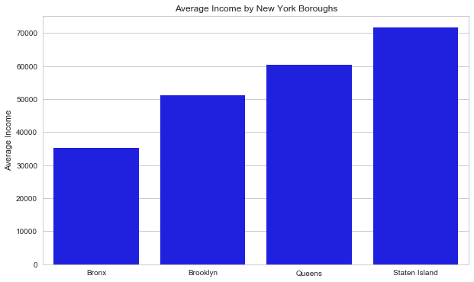
Focusing on Middle Income Neighborhoods
Notes:
Carl

Slide 5
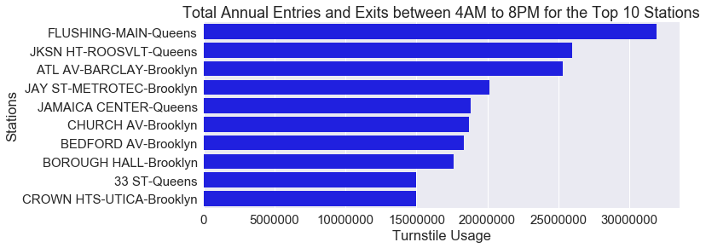
Identifying Foot Traffic in Target Neighborhoods
Notes:
Kenny
Identify stations with most foot traffic during Freshii’s BUSINESS HOURS
Top 3, Flushing Main and Jackson Heights in Queens, Atlantic Avenue/Barclay Center in Brooklyn

Slide 6
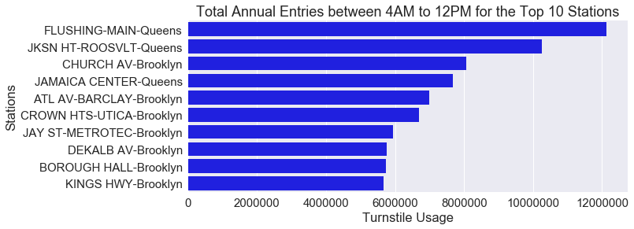
Morning Entries in Target Neighborhoods
Notes:
Kenny
Identifying locations with high local traffic by analysing entries into stations in the morning and exits in the evening. with the assumption that in general, people who enter a train station during the hours of the morning commute and people who exit during the evening commute are generally residents of those areas and thus align to the neighborhood demographics previously identified. Top 3

Slide 7
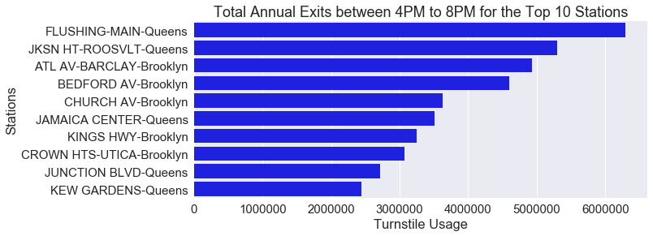
Evening Exits in Target Neighborhoods
Notes:
Kenny
Top 3, Flushing Main and Jackson Heights in Queens, Atlantic Avenue/Barclay Center in Brooklyn, where the Brooklyn Nets play which may skew the results since it captures people who exit that station in the evening to watch the Nets game or concerts

Slide 8
Conclusions and Proposed Additional Analyses
Where to place?
The stations highest across these top lists represent areas that both have high total pedestrian traffic and particularly high local pedestrian traffic during Freshii’s operating hours.
Flushing-Main and Jackson Heights–Roosevelt Avenue intersections near MTA stations in Queens
What’s next?
Hourly and seasonal analyses
Single borough analyses
Crime statistics
Commercial rental value data
Video captured pedestrian foot traffic data
Notes:
Laura = Conclusions and possible additional analyses with MTA data
These station not only have the highest overall traffic, but also have the highest local traffic in areas with residents who align to Freshii’s target demo.
Start with location near highest traffic station in Queens (Flushing-Main) and then expand to the following station (Heights-Roosevelt Ave 3 miles away along same subway line).
Optimal restaurant expansion strategy considered to be concentrating in one neighborhood and gaining a foothold before expanding to new neighborhoods.
Could expand analysis of this data set to provide optimal operating hours daily and seasonally.
Could expand analysis of this data set to provide recommendations for starting in any given borough (say Brooklyn next or expanding within Manhattan).
Could create a multi-criteria decision matrix with appropriate weighting for various concerns to assist in making final decision.
Prad = Not just one dimensional problem, multi criteria problem. Possible analyses with new data sources
Crime Statistics-- NYPD produces the crime data by precinct, Crimes like theft cause business interruption which is a top risk
Commercial rents like loopnet.

